Slide 1

Prepared by group 8
Knowledge Discovery and Data Mining
Multi-object Classification in Autonomus Driving
Section 513-C

Slide 2




Team Members
Bhushan Asati
Suyash Madhavi
Rujuta Dabake
Anirudh Sharma
20030940
20030933
20033905
20034386

Slide 3
Introduction and Problem Statement
Objective:
Developing a robust classification model for objects in autonomous driving environments.
Categories: Focusing on two broad categories: Human and Vehicle.
Significance:
Supports real-time decision-making in traffic scenarios.
Enhances the safety and efficiency of autonomous vehicles.

Slide 4
Dataset Description
Dataset Used
KITTI 3D Object Detection Dataset.
Multimodal Data:
Combines sensor data from images and LiDAR.
Original Categories:
Pedestrian, Cyclist, Car, Truck, Van, Tram, Miscellaneous.
Merged Categories into two main classes:
Human: Pedestrian, Cyclist.
Vehicle: Car, Truck, Van, Tram.
Dataset Size:
Over 7,481 labeled frames with detailed annotations, including 3D bounding boxes.
Size of dataset - 30 GB.

Slide 5



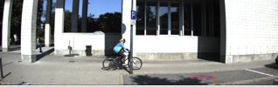
Visual Representation

Slide 6
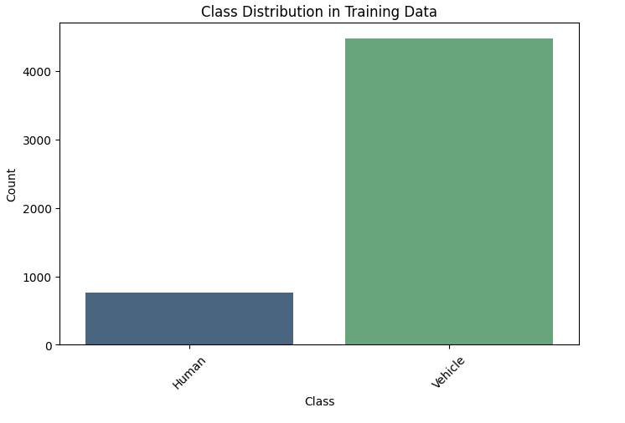
Data Distribution

Slide 7
Data Preprocessing
Extract and preprocess images from the KITTI dataset.
Normalize images to the range [0, 1].
Map object labels into the defined categories (Human and Vehicle).

Slide 8
Models Used
ResNet50
EfficientNetB0
MobileNetV2
Inception-V3
DenseNet-121
Faster R-CNN
XGBoost
Random Forest

Slide 9
ResNet50
Why Chosen
Residual connections prevent vanishing gradients in deep networks.
Proven reliability for feature extraction in diverse datasets.
Architecture
Consists of residual blocks with skip connections.
Pre-trained on ImageNet for transfer learning.
Fine-Tuning
Fully connected layer modified for Human/Vehicle classification.
Batch size: 32, Learning rate: 0.001, Optimizer: SGD.
Normalized input images for stable training.
Applications
Image recognition, medical diagnostics, and object tracking.

Slide 10
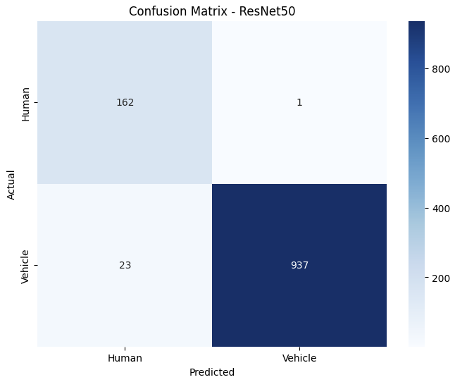
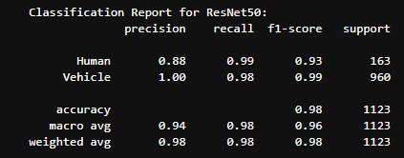

Slide 11
EfficientNetB0
Why Chosen
Balances accuracy and efficiency using compound scaling.
Suitable for scalable models on various hardware setups.
Architecture
Uniformly scales width, depth, and resolution.
Combines depth wise separable convolutions and squeeze-and-excitation modules.
Fine-Tuning
Adapted final layer for binary classification.
Batch size: 16, Learning rate: 0.0005, Optimizer: Adam.
Image resizing to match input dimensions (224x224).
Applications
Autonomous driving, drone navigation, real-time applications.

Slide 12
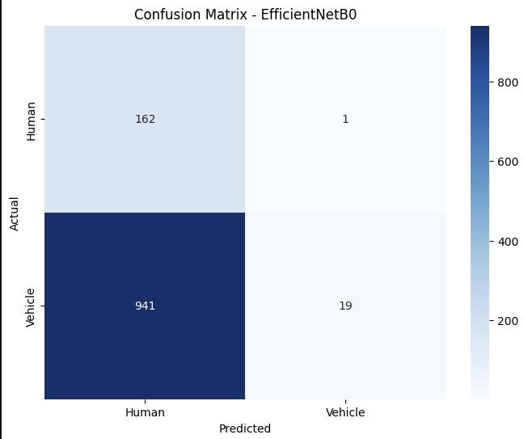
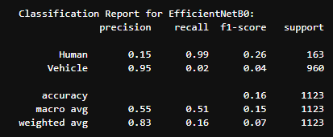

Slide 13
MobileNetV2
Why Chosen
Lightweight and efficient, ideal for deployment on mobile devices.
Depthwise separable convolutions reduce computational cost.
Architecture
Uses inverted residuals and linear bottlenecks.
Designed for speed and performance on resource-constrained environments.
Fine-Tuning
Adjusted final layer for Human/Vehicle classification.
Batch size: 32, Learning rate: 0.001, Optimizer: RMSProp.
Applied data augmentation to enhance generalization.
Applications
Mobile and embedded systems, AR/VR applications, and IoT devices.

Slide 14
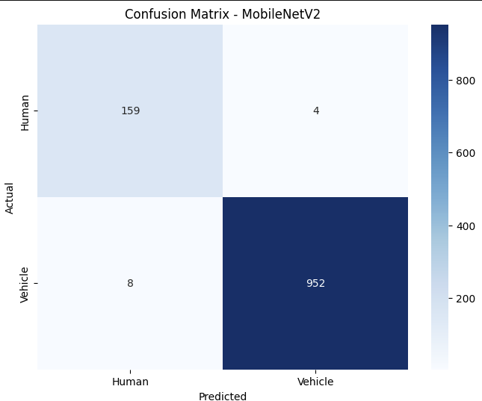
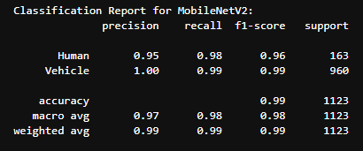

Slide 15
Inception-V3
Why Chosen
Known for multi-scale feature extraction using inception modules.
Ideal for tasks requiring a blend of speed and accuracy.
Architecture
Stacks inception modules for parallel convolutional layers.
Employs factorized convolutions to reduce computation.
Uses auxiliary classifiers to combat vanishing gradients.
Fine-Tuning
Modified final dense layer for binary classification.
Batch size: 32, Learning rate: 0.0001, Optimizer: RMSProp.
Augmented images with random rotations and flips.
Applications
Image classification, fine-grained object detection, medical imaging.

Slide 16
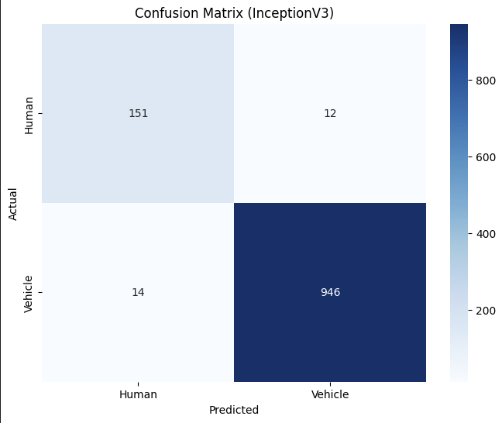
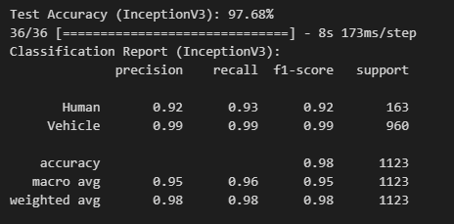

Slide 17
XGBoost
Why Chosen
State-of-the-art gradient boosting technique for structured/tabular data.
Handles missing values and imbalanced datasets effectively.
Architecture
Boosts weak learners (decision trees) iteratively.
Scales well with large datasets using parallel processing.
Regularization (L1/L2) minimizes overfitting.
Fine-Tuning
Learning rate: 0.05, Max depth: 6, Estimators: 100.
Applied early stopping to prevent overfitting.
Features scaled using StandardScaler before training.
Applications
Fraud detection, credit scoring, and feature-rich datasets like medical records.

Slide 18
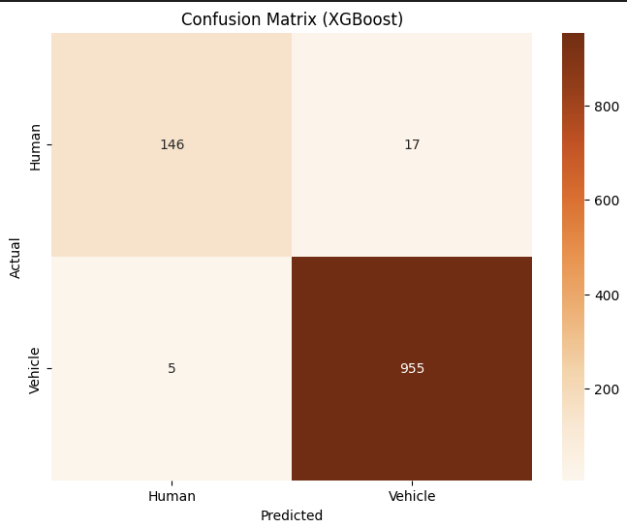
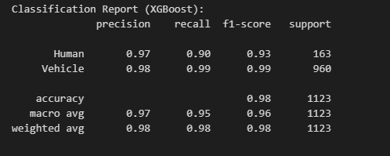

Slide 19
Faster R-CNN
Why Chosen
Specialized for object detection with high precision and recall.
Generates region proposals dynamically, improving detection efficiency.
Architecture
Combines a Region Proposal Network (RPN) with a CNN-based classifier.
Uses bounding boxes and classification scores for localization.
Fine-Tuning
Customized for detecting Human and Vehicle categories.
Batch size: 16, Learning rate: 0.0001, Optimizer: Adam.
Augmented dataset with bounding box annotations.
Applications
Autonomous driving, security surveillance, and robotics.

Slide 20
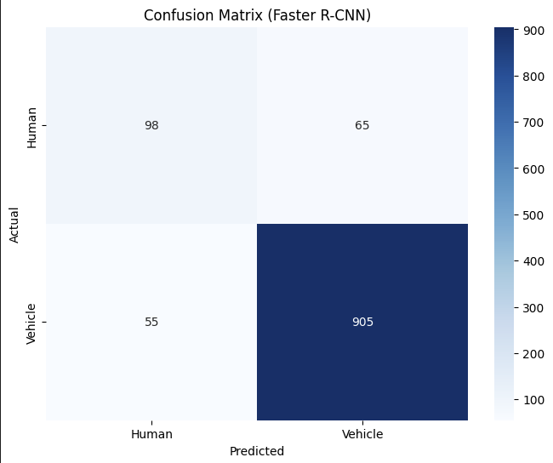
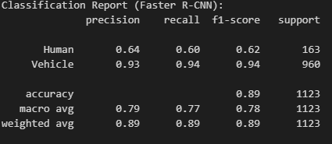

Slide 21
Random Forest
Why Chosen
Ensemble learning algorithm known for handling high-dimensional datasets.
Provides interpretability through feature importance.
Architecture
Combines multiple decision trees via bagging.
Outputs class prediction as the majority vote of individual trees.
Fine-Tuning
Number of trees: 200, Max depth: 10, Criterion: Gini.
Applied feature selection to reduce input dimensionality.
Applications
Classification tasks like credit scoring, customer segmentation, and fraud detection.

Slide 22
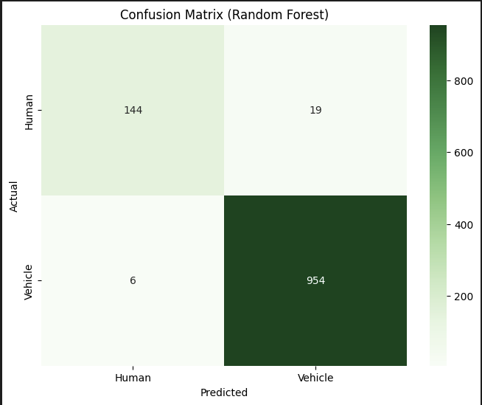
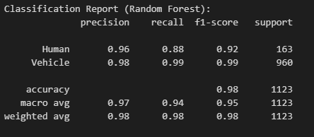

Slide 23
DenseNet121
Why Chosen
Feature reuse enhances gradient flow and reduces overfitting.
Efficient parameters, ideal for small datasets.
Architecture
Dense blocks connect all layers, preventing vanishing gradients.
Pre-trained on ImageNet for transfer learning.
Fine-Tuning
Fully connected layer modified for Human/Vehicle classification.
Batch size: 32, Learning rate: 0.001, Optimizer: Adam.
Data augmentation: rotation, flipping, zooming.
Applications
Medical imaging, autonomous driving, surveillance systems.

Slide 24
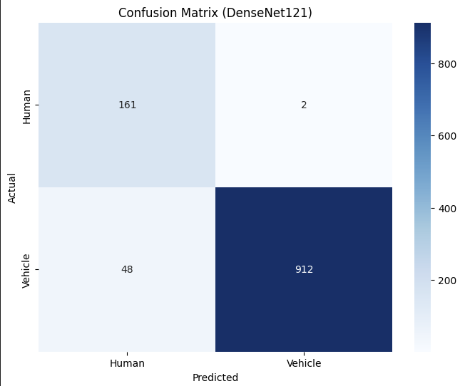
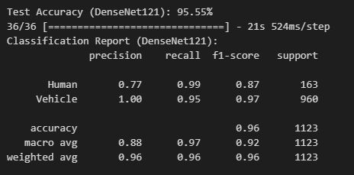

Slide 25
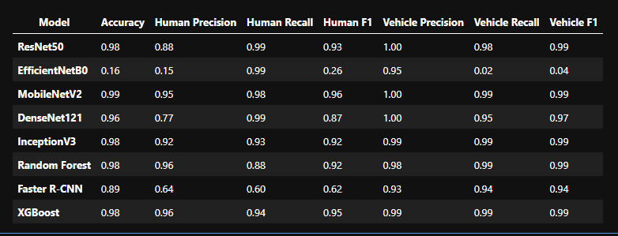
Results

Slide 26
Best-Performing Model: DenseNet121
Highest Accuracy: Achieved 96% overall accuracy.
Exceptional Metrics:
Human Class: Precision = 0.77, Recall = 0.99, F1-Score = 0.87
Vehicle Class: Precision = 1.00, Recall = 0.99, F1-Score = 0.97
Advantages:
Reduces the Vanishing Gradient Problem.
Reduction in Overfitting
Encourages Diverse Feature Learning

Slide 27
Thank you

